Slide 1





Innovative business model concepts and frameworks – climate entrepreneurship and innovation
CLIMATE FINANCE AND INNOVATIVE BUSINESS MODELS
Pedro Chilambe; Finance and Investments Co-lead, Team lead Climate Finance.
p.chilambe@cgiar.org

Slide 2
Agenda
Why Innovation in Agriculture?
Overview: Osterwalder Business Model Canvas
Overview: Value Proposition Canvas
Applying These Tools to Agriculture
Examples & Case Studies
Q&A

Slide 3
Why Innovation in Agriculture?
Global Challenges: Climate change, business case, resource scarcity.
Market Dynamics: Changing consumer preferences (organic, sustainable), rising demand for transparency, digitalization of supply chains.
Adaptation Imperatives: Need for resilient farming practices, risk management, and efficiency.
Innovation Opportunity: Technologies (IoT, AI, drones), regenerative agriculture, precision farming, novel value-adding services.

Slide 4

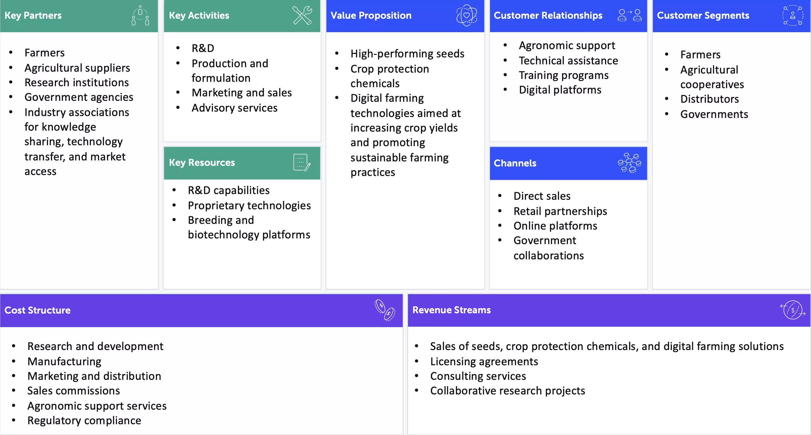


Slide 5
Business Model Canvas: Overview
Customer Segments:
Who are the target customers? What are their key needs and characteristics?
Segments can include individual consumers, businesses, farmers, retailers, cooperatives, or government agencies.
Value Propositions:
What problems does the business solve for its customers?
What unique value does it offer (e.g., higher crop yield, cost reduction, sustainability)?
Examples: organic produce, precision farming solutions, supply chain transparency, crop insurance.

Slide 6
Business Model Canvas: Overview
Channels:
How does the business reach customers?
Can be physical (retail stores, distribution networks, farmer cooperatives)
or digital (e-commerce, mobile platforms, agritech apps).
Customer Relationships
How does the business interact with customers?
Is it self-service, personal assistance, automated, or community-based?
Example: direct farmer support programs, training workshops, AI-driven customer support.

Slide 7
Business Model Canvas: Overview
Revenue Streams:
How does the business generate income?
Examples: direct sales, subscriptions (e.g., farm management software), licensing fees, value-added services.
Key Resources:
What assets are necessary to deliver the value proposition?
Examples: land, equipment, technology, intellectual property, expert knowledge, partnerships.

Slide 8
Business Model Canvas: Overview
Key Activities:
What does the business need to do to operate successfully?
Examples: farming, processing, R&D, logistics, distribution, marketing, customer engagement.
Key Partnerships
Who are the external partners that support the business?
Examples: suppliers, technology providers, research institutions, NGOs, financial institutions.

Slide 9
Business Model Canvas: Overview
Cost Structure
What are the major costs associated with running the business?
Examples: production costs, labor, marketing, R&D, logistics.

Slide 10
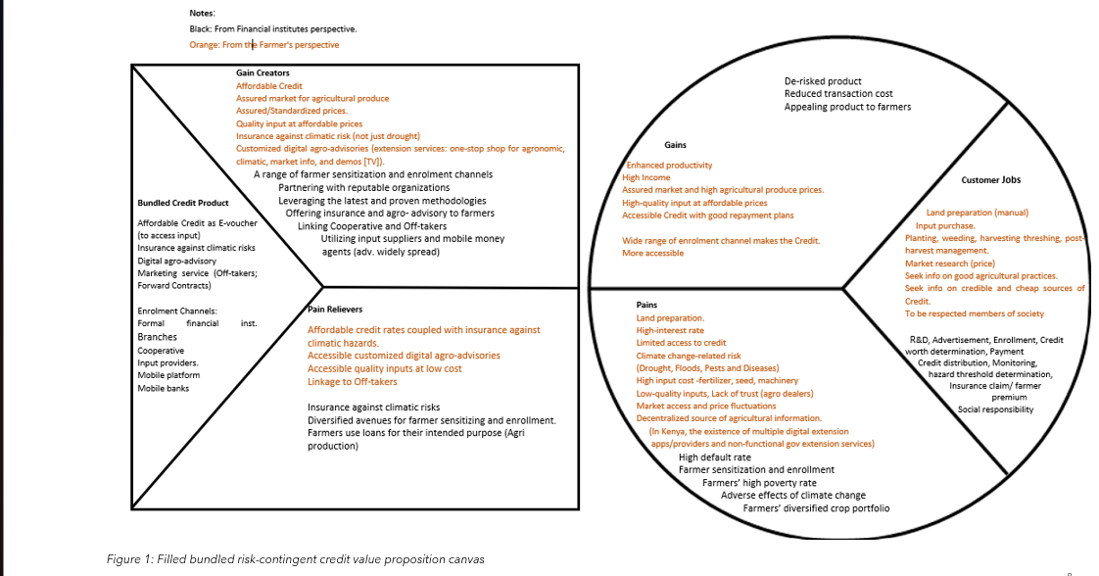

Slide 11
Thank you

